Slide 1
TEAM PROJECT PRACTICE
https://github.com/tnt-summer-academy/Curriculum-2022/blob/main/Week%202/%5BENG2.6%5D-TeamProjectPractice.md

Slide 2
GOAL: START PRACTICING THE PROCESS THAT YOU'LL USE TO DEVELOP YOUR PROTOTYPE APP
Gain experience to break out work, code together and resolve git merge conflict to be prepared for the project

Slide 3
THE YOURSHARE PROJECT
WORK ON IT THIS WEEK AND PART OF NEXT WEEK
In GitHub: TeamXX-2022-AppPrototype
Check your repository

Slide 4
WORK NEEDS TO BE REVIEWED BY THE COACHES FOR SIGN-OFF

Slide 5
Learning objectives
TNTs will understand how to break down work.
TNTs will understand how to scope work.
TNTs will practice merging and resolving merge conflicts when working collaboratively.
Notes:
TNTs will begin working on the navigation.

Slide 6
PART 0 YOURSHARE SPEC
https://github.com/tnt-summer-academy/Curriculum-2021/blob/main/Reference/Sample%20spec%20-%20YourShare.md

Slide 7
Problem statement
There's value in what communities collectively own today that's untapped. People are likely to buy something they use infrequently and there are barriers to sharing and discovering what's available in friend and community circles. How might we enable individuals to share what they own, reducing waste and creating stronger local communities.

Slide 8
Customer profile
YourShare's initial target market is college students and the communities around college and university campuses.

Slide 9
User stories by priorities
P0: A user can sign-up for the app
P0: A user can post new items
P0: A user can browse items
P0: A user can request to borrow items
P0: A user can add friends and manage permissions
P1: A user can manage the items they have posted
P1: A user can sort items
P2: A user can upload a photo of the item.
P2: A user can search for items
P2: A user can see items on a map

Slide 10
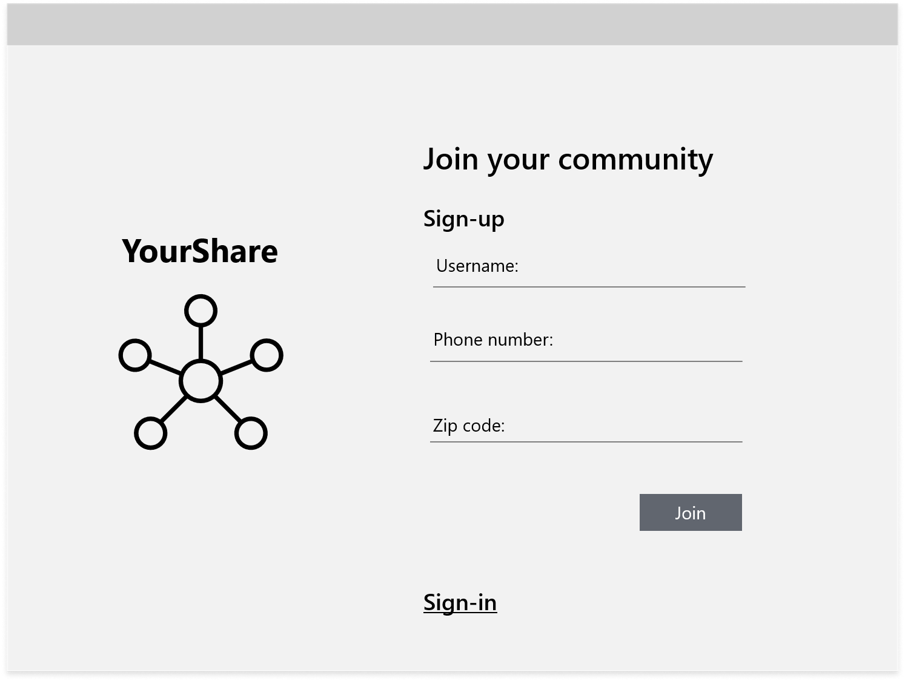
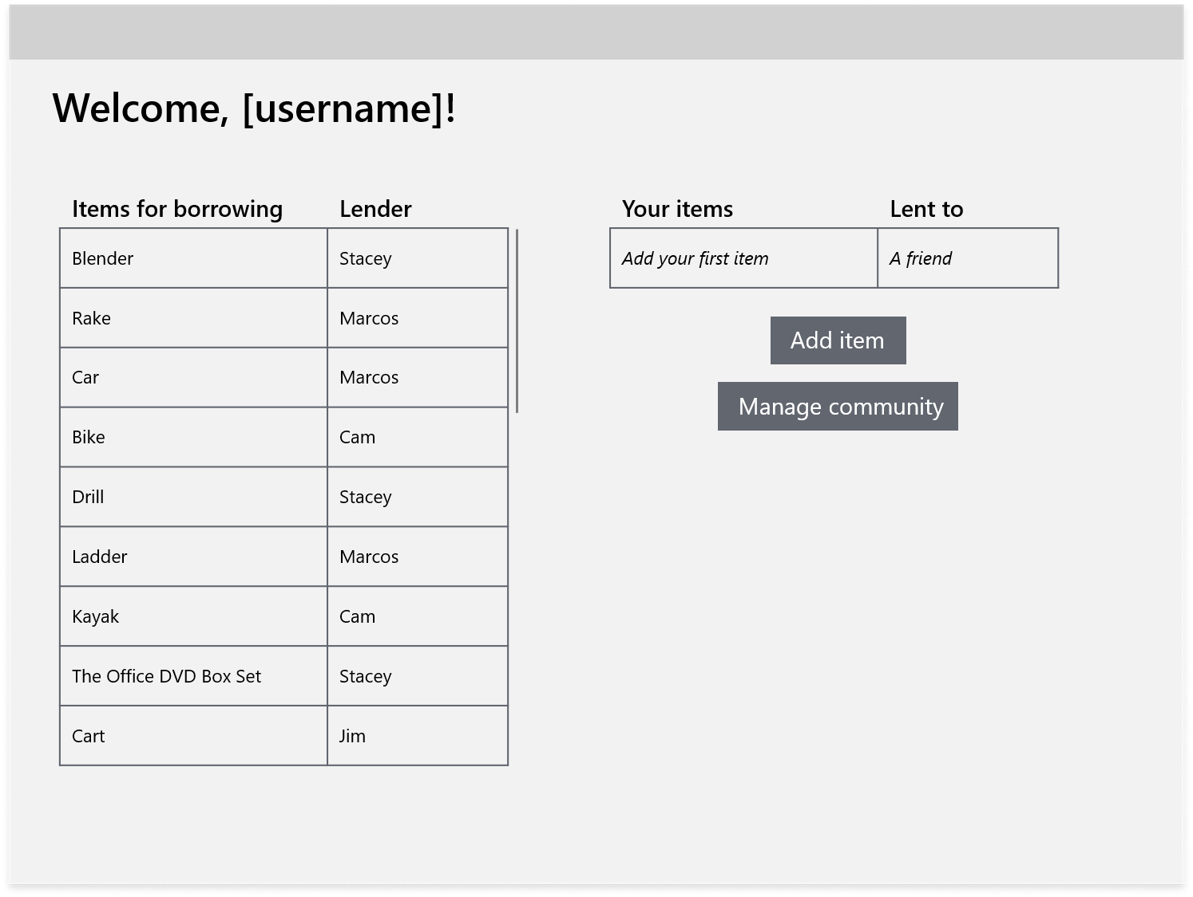

Slide 11
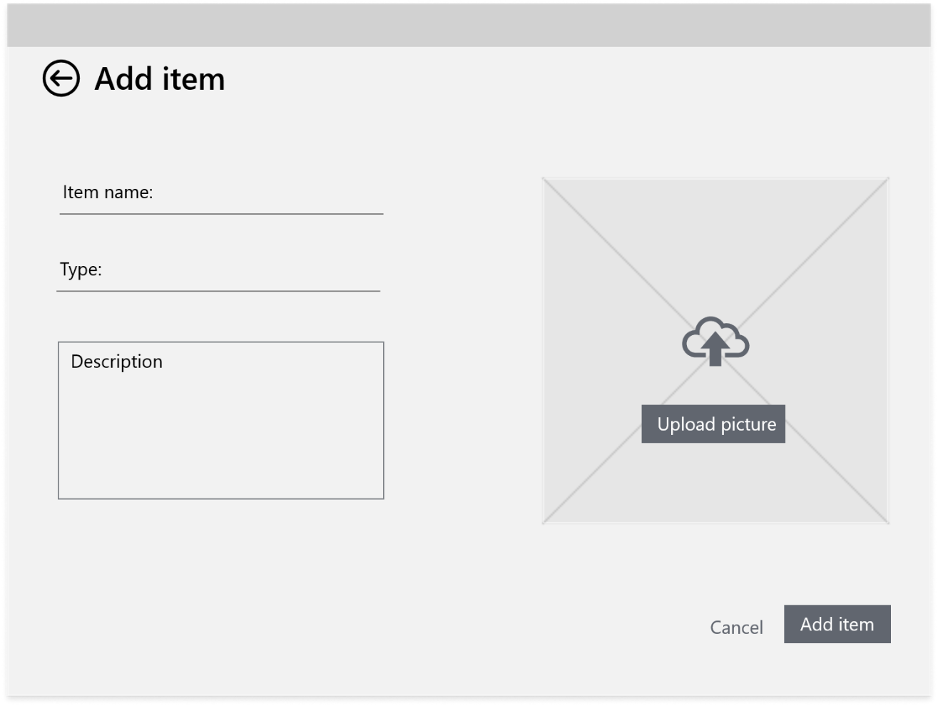
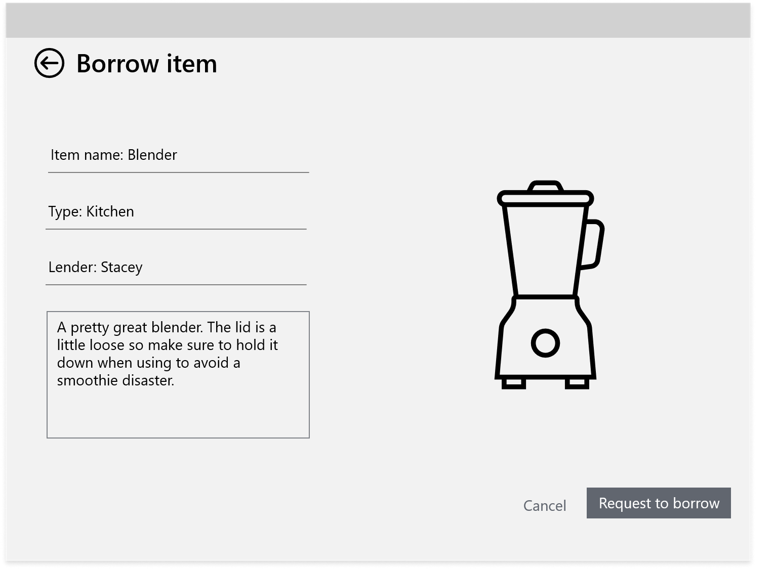

Slide 12
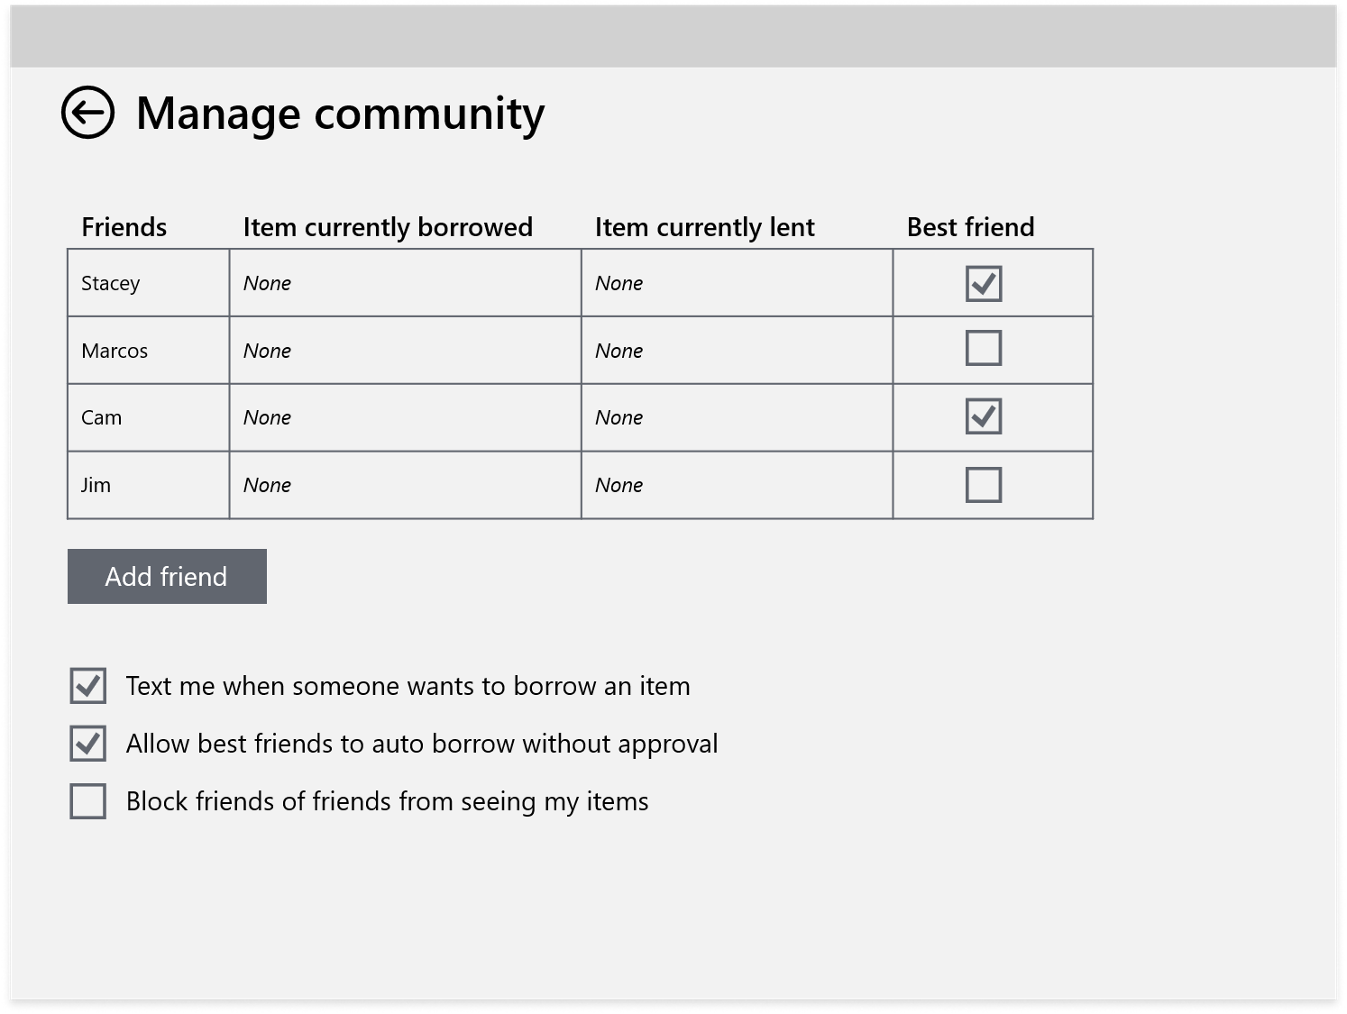

Slide 13
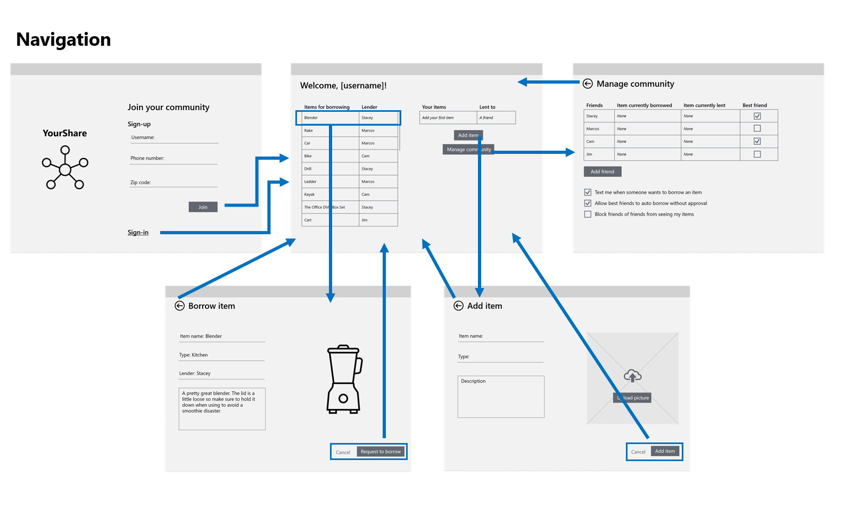

Slide 14
PART 1 KANBAN WORK IN GITHUB
Demo
https://github.com/tnt-summer-academy/Team00-AppPrototype
Notes:
5 minutes
https://github.com/tnt-summer-academy/NameandFavFood

Slide 15
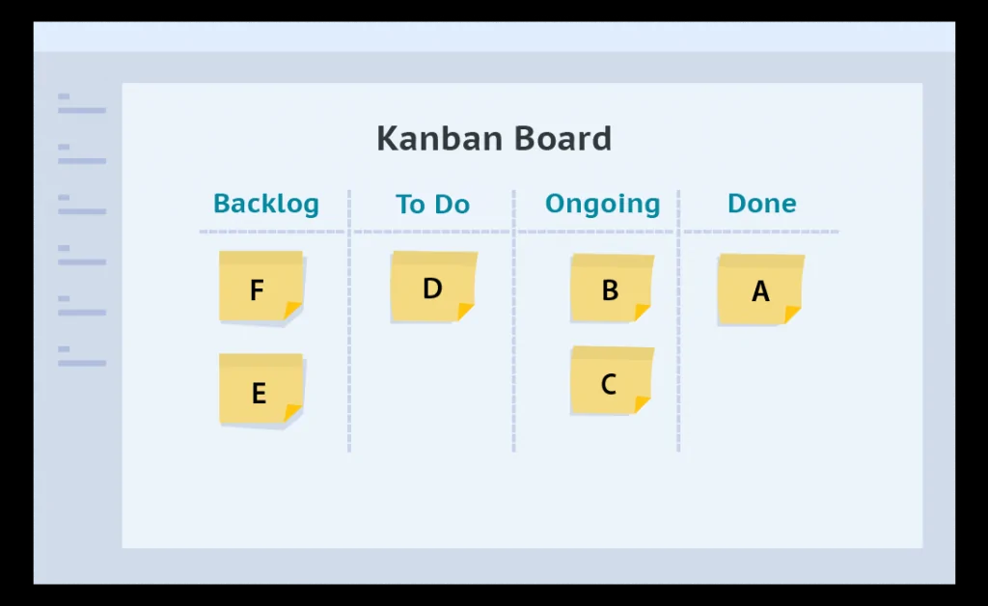
Kanban board
“A kanban board is one of the tools that can be used to implement kanban to manage work at a personal or organizational level. Kanban boards visually depict work at various stages of a process using cards to represent work items and columns to represent each stage of the process.” [wikipedia]
https://www.digite.com/kanban/kanban-board/
Notes:
Kanban is a methodology centered around visualizing tasks, while Scrum is a methodology that structures workflow and team culture to deliver projects in short timelines. Kanban delivers tasks continuously until the project is finished, while Scrum delivers chunks of deliverables in one- to four-week periods.

Slide 16
Tour of Projects
Go to Projects
Click on Projects
Show the Kanban board
Show the Cards
Show the details of a card
Assigned to one person
Cards can move from one person to another
Definition of Done – Done when …

Slide 17
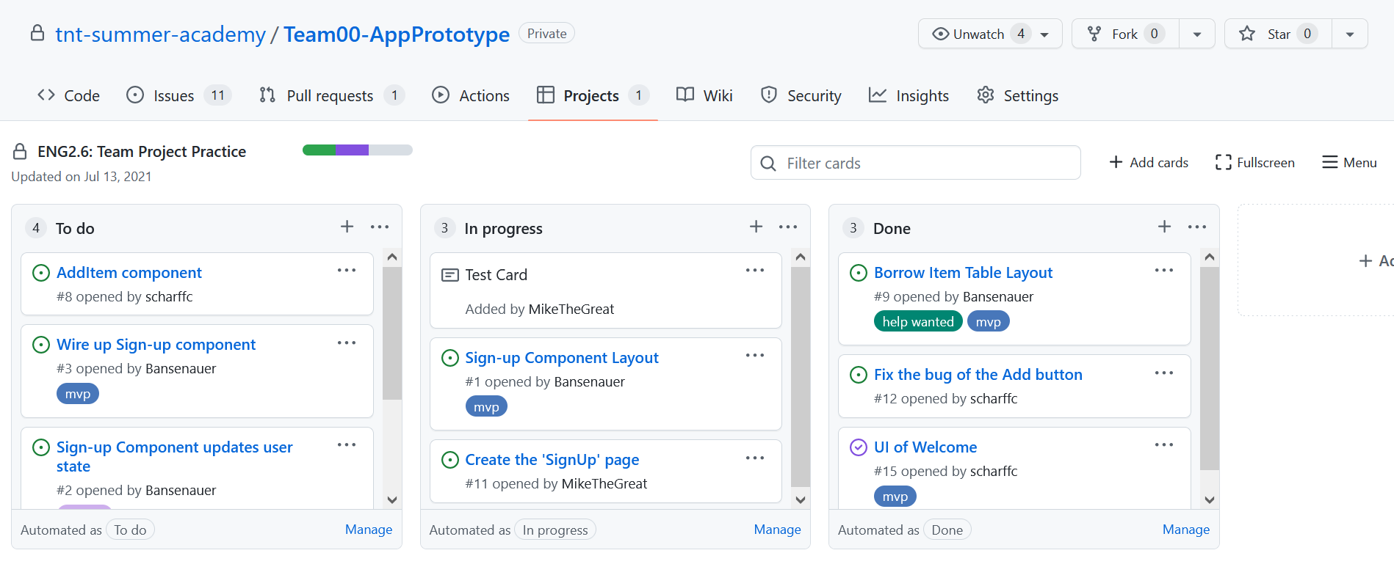

Slide 18
PART 2 ADDING A NEW NOTE / CARD
Demo
5 minutes

Slide 19
Tour of Notes
Create a note in the todo column
Add it
Convert it to an issue
Type the additional info in the body of the issue
Done when
Be sure it is assigned!

Slide 20
PART 3 BREAKING DOWN WORK
15 minutes

Slide 21
GO TO GITHUB: HTTPS://GITHUB.COM/TNT-SUMMER-ACADEMY/TEAM00-APPPROTOTYPE
Go to the file componentdecomposition.md for an example
Notes:
https://github.com/tnt-summer-academy/Team00-AppPrototype/blob/main/yourshare/componentdecomposition.md

Slide 22
Breaking down work – as a team
You will work from the spec of YourShare
Use the YourShare repo
Examine the spec as a team, paying attention to the various pages and the navigation between them
Create 1 card per page in order to break down the overall work into specific steps
Each card must have Done when …
Each card must be assigned to a specific person of your team

Slide 23
PART 4 BREAKING A PAGE INTO COMPONENTS
Demo
5 minutes

Slide 25
What could be components?
Think about what elements of a page are naturally grouped together
Think about t what you may want to move around on the page
Look at things that are repeated across different pages

Slide 26
PART 5 BREAKING A PAGE INTO COMPONENTS
15 minutes

Slide 27
Breaking a page into components Documented in markdown page
Choose a single page to work on together
Break that page into individual components
This will be done in a Markdown file
Go to the yourshare repository
Create a markdown page with the list of components of that page
## Name of the component
2-3 lines of description
Markdown syntax
https://guides.github.com/features/mastering-markdown
Review your work with your coaches for a signoff before starting building

Slide 28
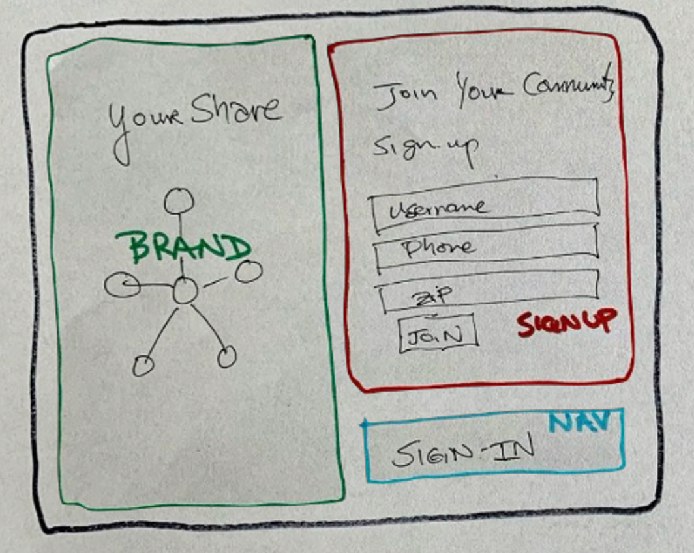
Example - PO - SignUp
https://github.com/tnt-summer-academy/Team00-AppPrototype/blob/main/yourshare/componentdecomposition.md

Slide 29
PART 6 HOW TO DO MULTI-PAGE NAVIGATION IN REACT (WITHOUT REACT ROUTER)
Demo
10 minutes

Slide 30
Go to your team project

Slide 31

App.js file
The state of App is defined as the currentPage
pages is an object
A switch statement decides which component (page) to return and render based on the state's currentPage value
changeScreen() switches between pages
How to change page?
Sample from SignUpPage.js

Slide 32
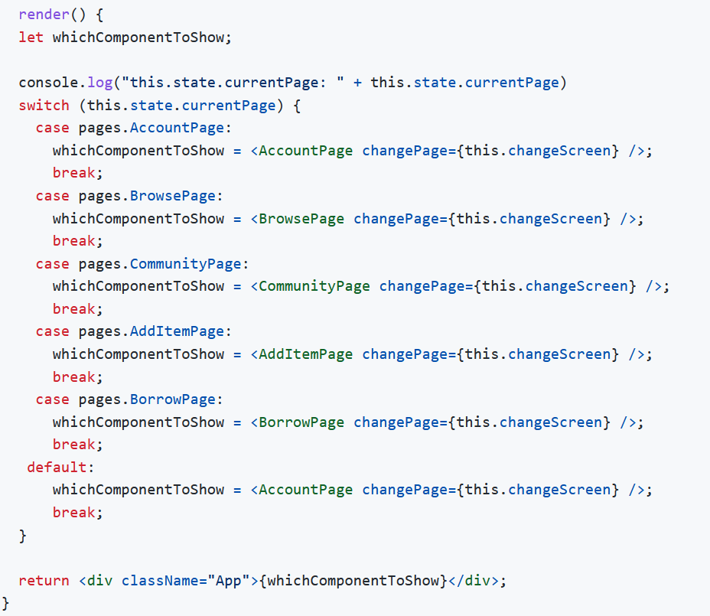

Slide 33
PART 7 START CODING UP THE PAGE NAVIGATION
5 minutes

Slide 34
Begin coding the navigation
Start coding the navigation
1. Use the repo that was created
2. Clone the repo
3. Create a new branch for individual work on
4. Create a new component page for your page and add the corresponding code in the main page
5. Once the coaches validate your work you can begin to work on your page
6/7. Pull, push, request pulls, branch etc. and resolve merge conflicts together

Slide 35
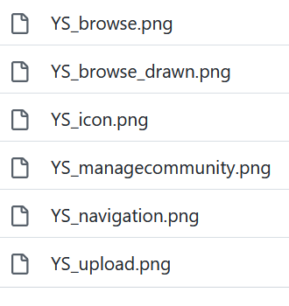
Next part
Connect the different pages
Make the pages look like the pages in the spec
Assets are provided
https://github.com/tnt-summer-academy/Curriculum/tree/main/Reference/YourShare-screens
We will be working on the UI and functionalities this week and part of next week

Slide 36
WE WILL WORK ON THIS APP THIS WEEK AND PART OF NEXT WEEK

Slide 37
YOU WILL PRESENT YOUR FINAL WORK

Slide 38
WE WILL COVER ROUTERS NEXT

